Slide 1
Preparing for a Labor Strike Presented by Amy Idsvoog
July 14, 2018

Slide 2
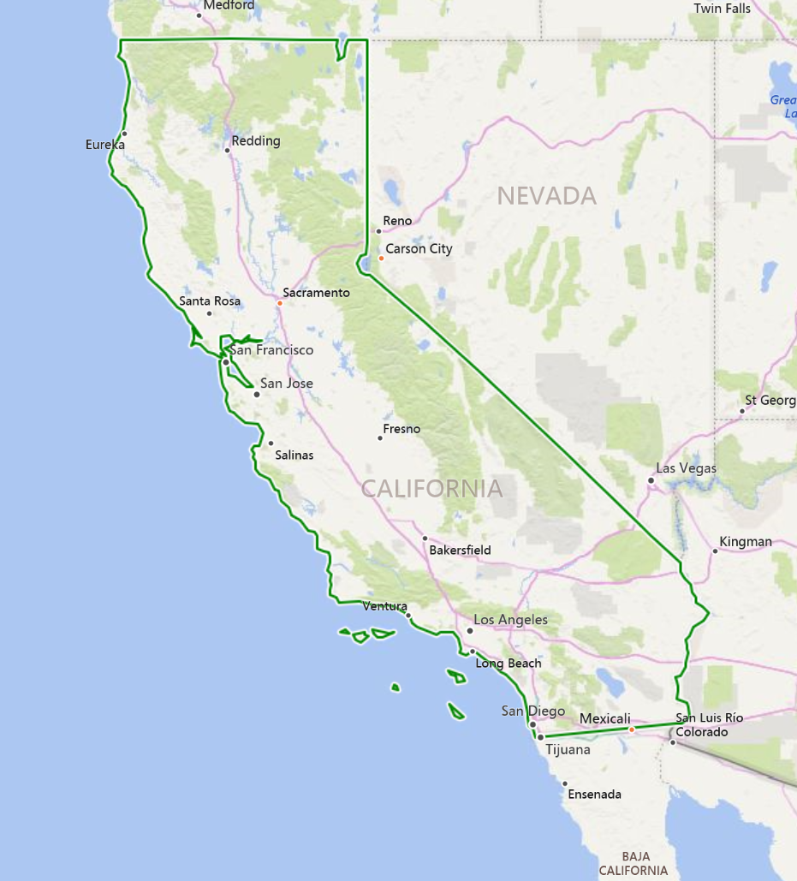
Fresno Unified School District
Located in Central California
4th largest school district in California
74,000 students
88% of those students live in poverty
10,000 employees
7 Labor Unions
Largest is Fresno Teachers Association with almost 4,000 members (teachers, nurses and speech language pathologist)
Notes:
SEIU, FTA, FAFSA, CSEA 125, CSEA 143 food service and two trade units

Slide 3
Negotiations Timeline
June
2017
Last Best and Final Proposals Presented
August 2017
Start of school with no agreement
August 2017
Discussions began around potential strike
February 2017
Sup left after 12 years and interim was named
July
2016
Negotiations began; talk of “strike”

Slide 4
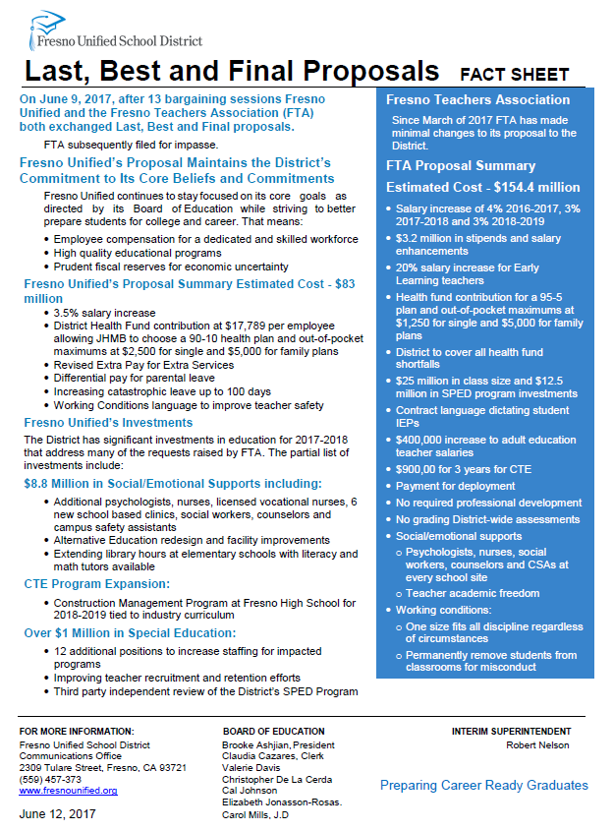
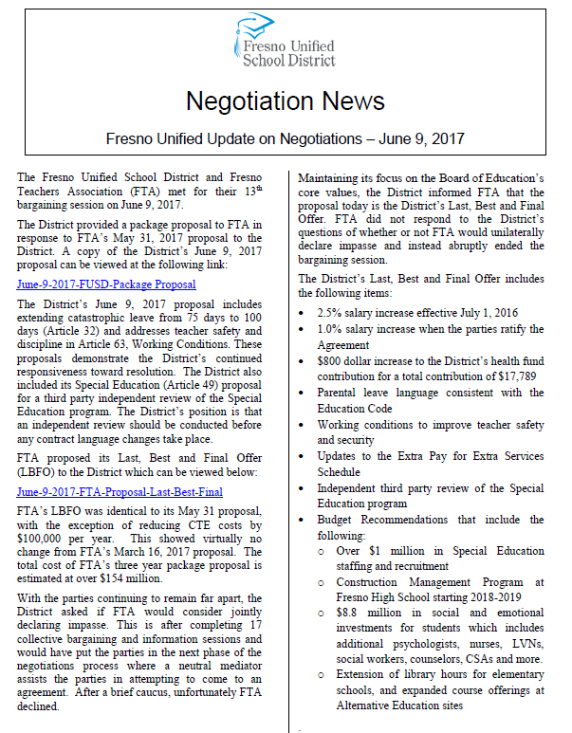
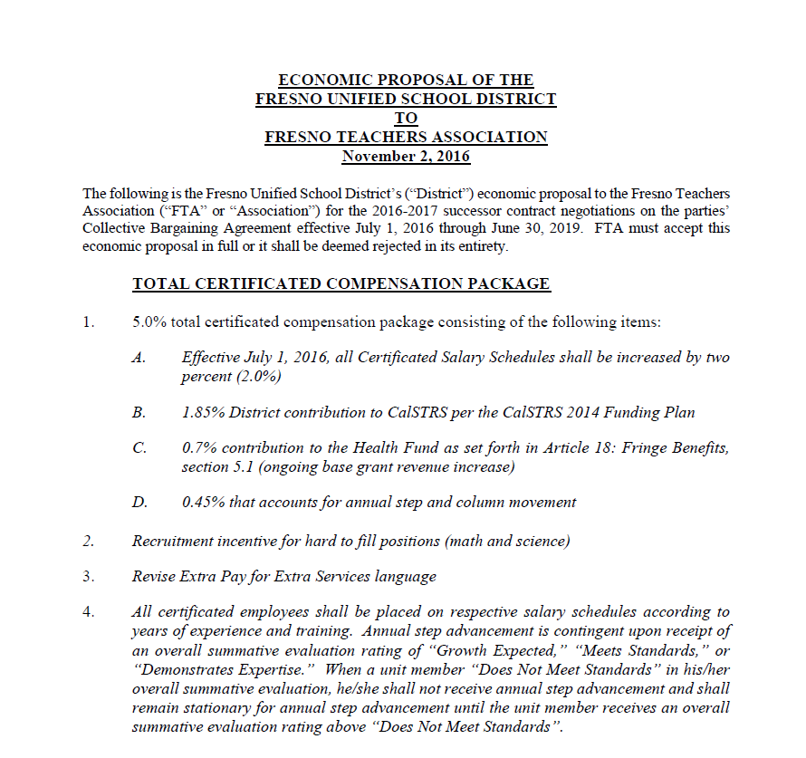
Initial Messaging

Slide 5
Our Realities
Fact Finding had always gone in our favor, so internally some leaders believed a strike would never happen
Preparation for a potential strike was ok but it shouldn’t distract site leaders and daily instruction
Hadn’t had a strike in nearly 40 years
Many site leaders weren’t engaging staff around misinformation— They were Switzerland
Social media rhetoric was creating negative energy and bad blood
Folks weren’t reading negotiation material and the “Fake News” was flying on social media
We needed to educate employees and the community above the noise

Slide 6
First Big Decision
In the event of a teacher strike, do we . . .
A. Keep schools open?
B. Close schools and keep kids at home?

Slide 7
Sound Advice
“The best way to avoid a strike is to be well prepared for one.”
Jim Whitlock, Consultant

Slide 8
Provided First Hand Knowledge
90% of teachers will not report to work
50% students will not attend
500 active substitutes in the system; State-wide teacher shortage
Organizer tactics:
No lesson plans left behind
There have been incidents of classroom and systems sabotage
Focus is on making it difficult to keep schools open
Don’t underestimate security and make sure to have a “Plan B” for your “Plan B”

Slide 9
Important Elements of Strike Management
Nine Elements
1. Strike Response Coordinator
2. Strike Response Team
3. Communications
4. Enrichment Curriculum
5. Replacement Staffing
6. Site Security
7. Emergency Operations
8. Board Relationships
9. Post Strike Recovery

Slide 10
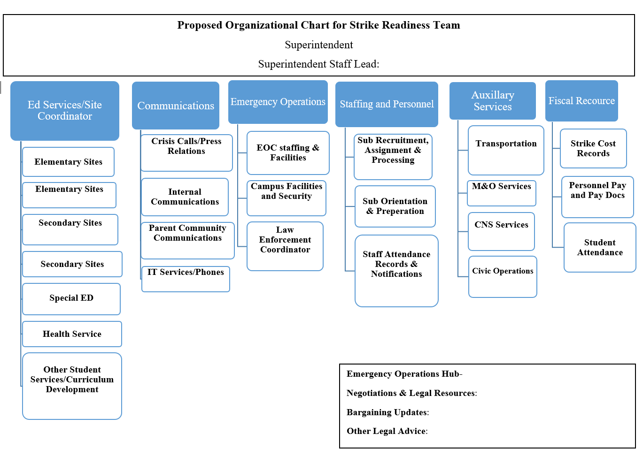
Strike Readiness Team Support
Notes:
Ed Services– creating curriculum and class supplies based on grade bands 1st and 2nd, 3rd and 4th, etc., printing, distributing to sites, developing alternative bell schedules, attendance procedures, additional supports . . . We’re we going to grade? Would extra curricular activities occur—sports, clubs, etc.?
Communications– messaging to all stakeholders including community partners that support district throughout the school year, planning for potential sabotage; student records, technical issues, social media, crisis response, talking points for everything– communicating to staff, principals and creating a principal guidebook . . Including daily strike reports
Emergency Operations– Safety of facilities and our Executive team, as well as our school sites and district office . . . Hire additional safety personnel; coordinate with police, sheriff and first responders to ensure day to day safety operations--- review and revamp arrival/departure patterns for students and staff during potential picketing, check in process. Key control was a hot topic
Staffing and personnel– our toughest hurdle was to recruit, interview, hire, conduct orientation and finger print and process . . .
Auxiliary Services– this was the team that printed curriculum district wide, developed plan B for bus routes (perhaps alternative areas for drop off and pick up, maintenance and operations, food services and civic rental agreements with our community– in the event of a work stoppage, facilities would be closed outside of the regular school day.
Fiscal services– supported student attendance efforts for reporting ADA, paying subs and kept track of the money being spent.

Slide 11
Negotiations Timeline
September 7, 2017
FTA began promoting date for strike vote
September 14, 2017
Certified for Fact Finding
October
3, 2017
FTA votes to strike
September 28, 2017
District provides updated proposal
October
4, 2017
Emergency Resolution signed and readiness plan launched
Notes:
September 7, 2017 FTA publicly began promoting an October 3rd membership meeting to VOTE on a potential strike
September 14, 2017 Mediator certified both parties for Fact Finding
September 28, 2017 District provides updated proposal
October 3, 2017 FTA voted to strike if deal was not made
October 4, 2017 Board of Education adopted Emergency Resolution
October 4, 2017 Strike Readiness communication plan officially launched
October 27, 2017 After 25 session, Fact Finding process begins

Slide 12
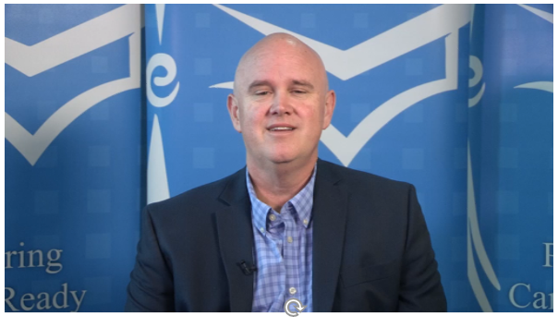
Began Communicating Differently

Slide 13
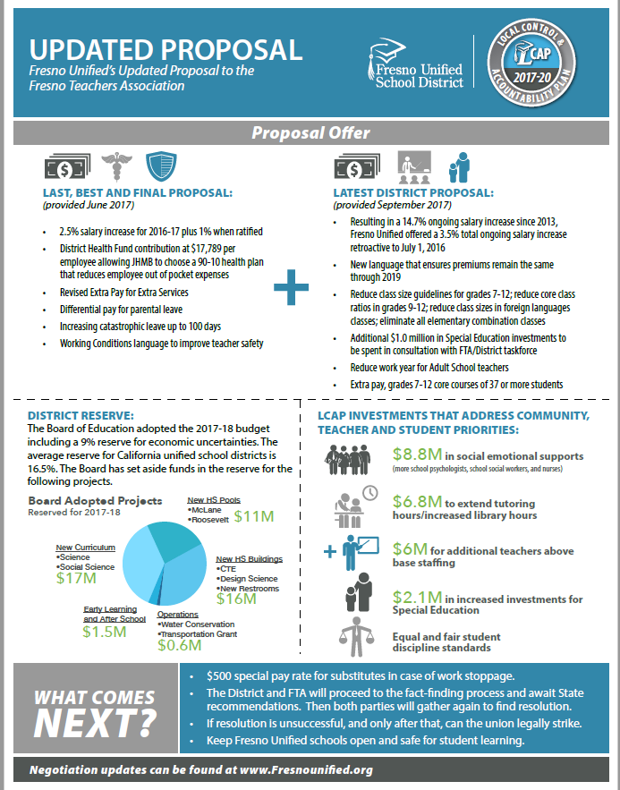
Developing a Communication Plan that Reaches all Stakeholders
Our Key Messages:
Our Proposal—”What was on the Table”
A vote to strike did not mean a strike was imminent
Fresno Unified schools would remain open and safe for learning
Recruiting/hiring qualified substitute teachers was vital to ensure students stayed on track academically should a strike occur
Notes:
This all had to be done without direct bargaining which would have resulted in an Unfair Labor Practice

Slide 14
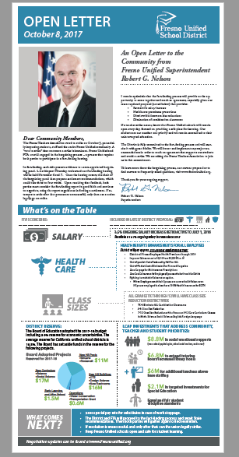
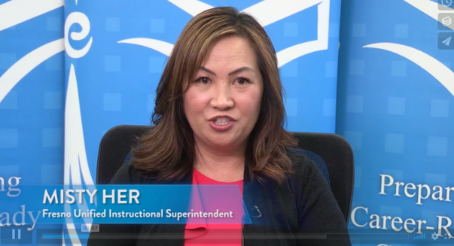
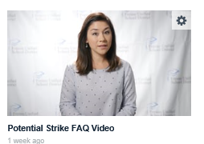
Communications and Supports
Outreach:
Radio, TV and movie theater commercials
Print ads and media interviews
Flyers and videos pushed out on social media
Employee Zone/District Update/Community Zone
Phone Messages
Building Futures Newspaper
Leadership Talking Points

Slide 15
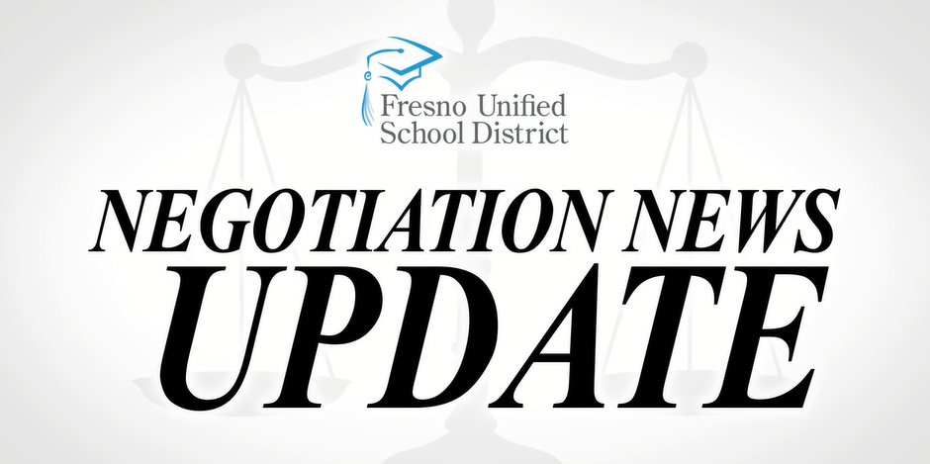
Communications and Supports
Outreach:
District Website
Superintendent emails and video updates to staff
Online and video FAQ’s
Board remarks
Press Events
Negotiation News video series
Whiteboard video animation
District :60 News

Slide 16
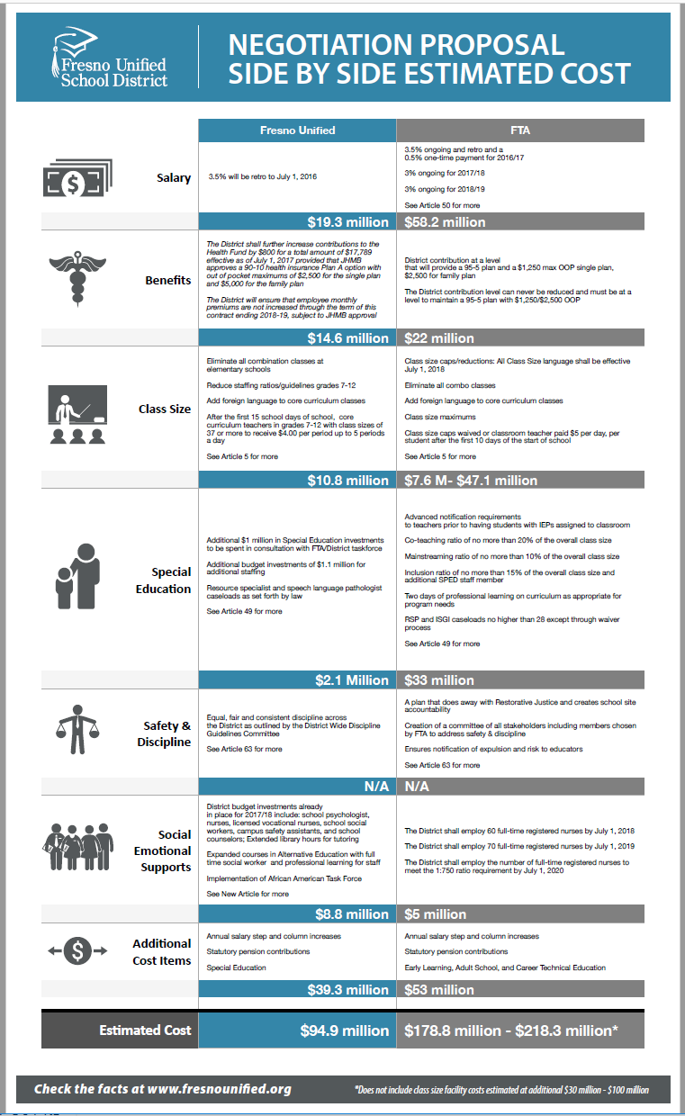
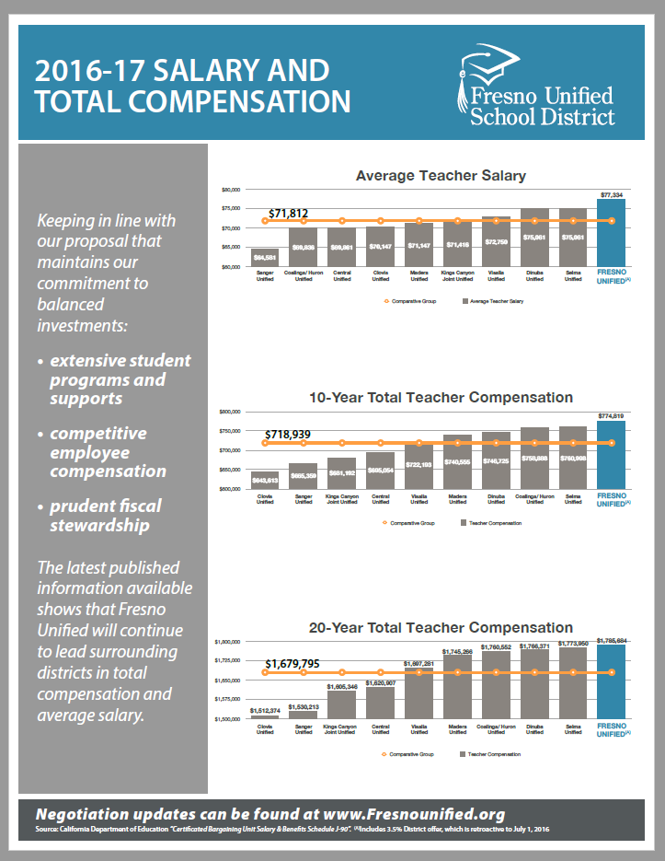
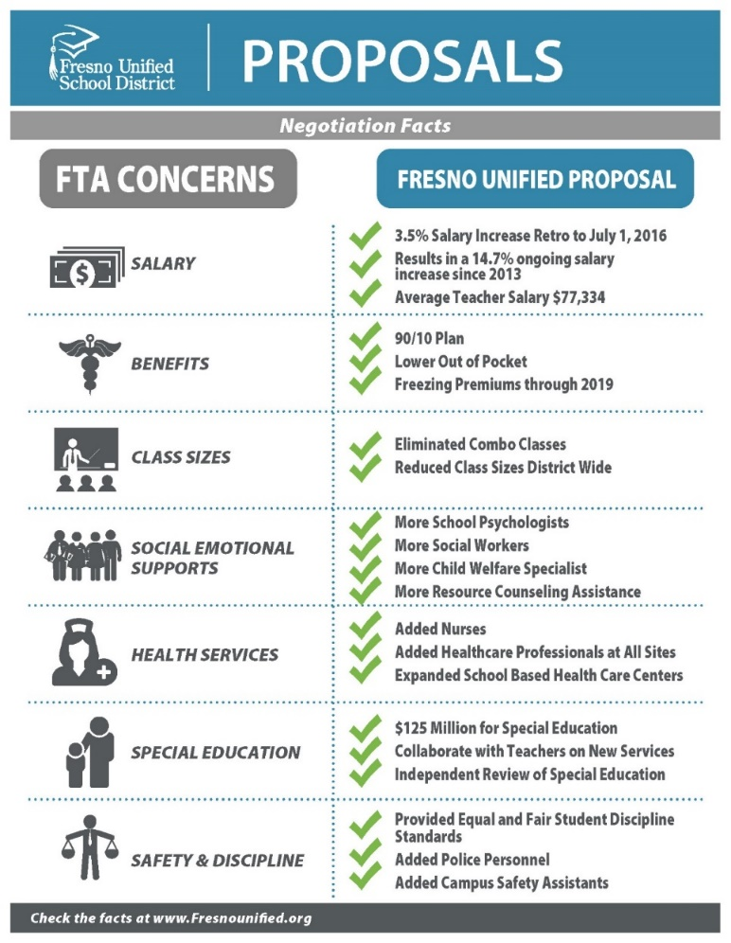
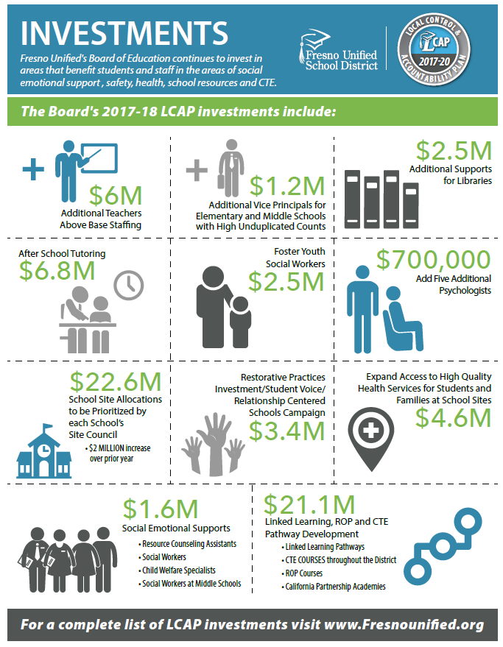

Slide 17
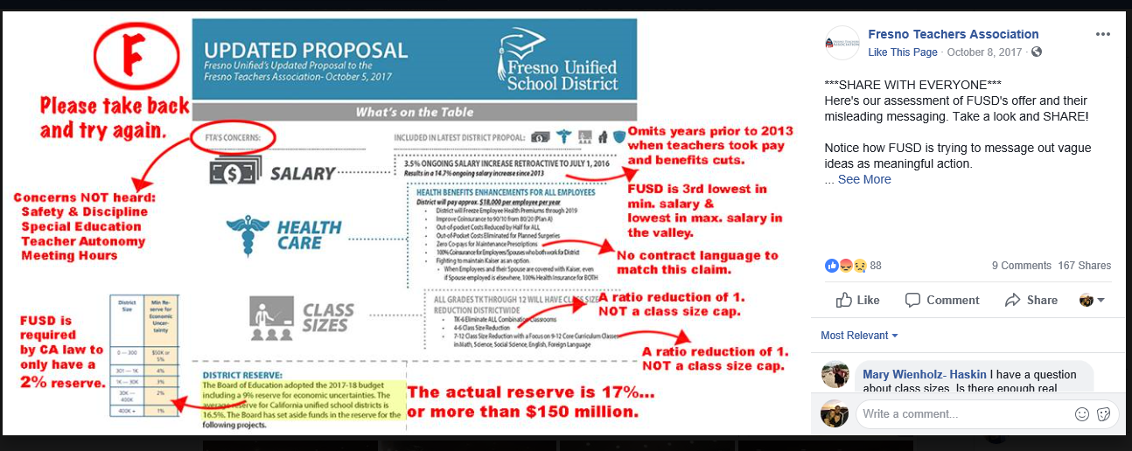
Everything we put out . . .

Slide 18
Everything we put out . . .

Slide 19
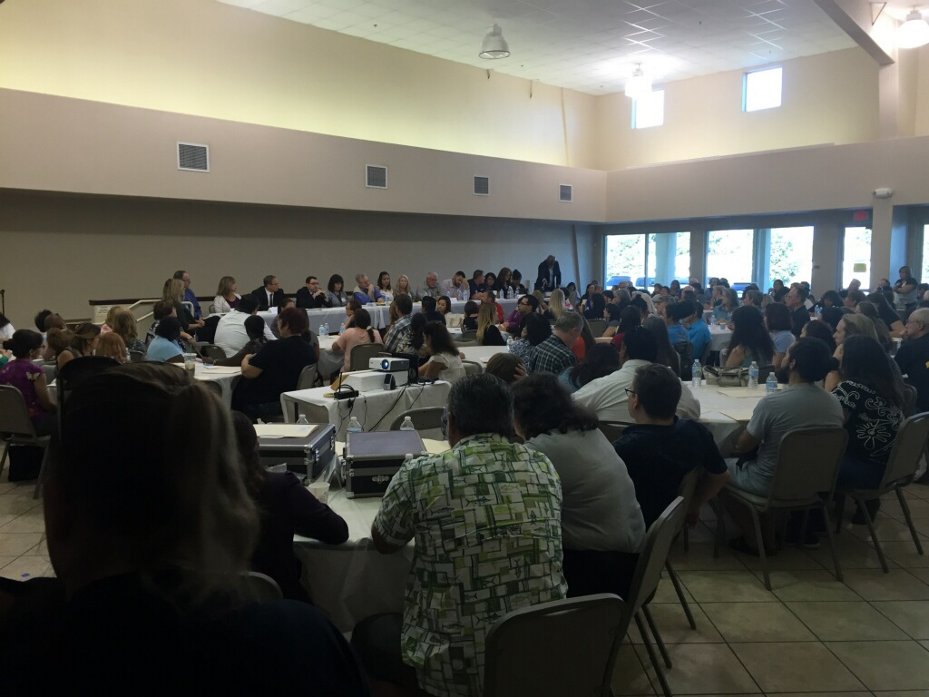
Contentious Bargaining Sessions

Slide 20
Developing a Communication Plan
Substitute Recruiting
Tools:
Offer $500 a day
Primary website presence
Radio commercials throughout California
Morning news shows
TV/Movie theater ads
Social media
School messenger
Press conferences
News articles

Slide 21
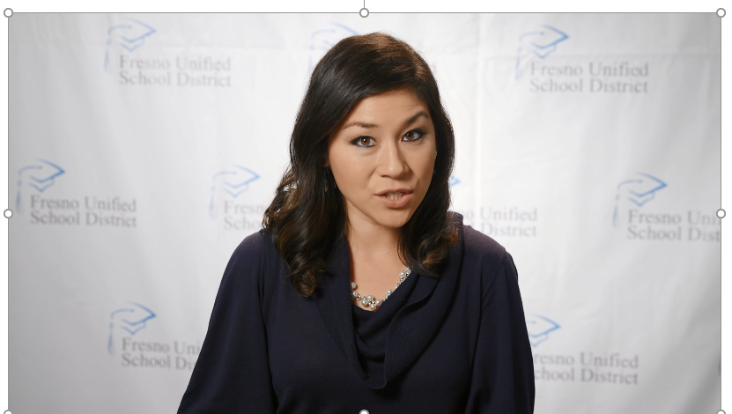
Recruiting Qualified Substitute Teachers

Slide 22
Face to Face Communication
Developed Work Stoppage Manual
Weekly Readiness Team Meetings
Weekly Lead Readiness Meetings
Weekly Cabinet Updates
Held Weekly Principal Meetings
Notes:
Manual was done in conjunction with our legal team– it outlined everything from the Role of the Administrator to preparing for a work stoppage to tips in managing in your site when it occurs. It also provided FAQs for staff, forms, reports, and general processes and procedures under an active work stoppage. It covered pre planning, during a strike and post recovery best practices
Weekly Team Meetings to identify trouble spots, progress and next steps
Weekly Lead Team– included Police, Sherriff and Safety, providing updates on progress and trouble areas based on what we were hearing from team meetings
Principal meetings started in October and ran through December– off site, after hours beginning at 4:30 p.m., included food . . . With a bonus meeting on the day we reached a TA

Slide 23
Biggest Hurdles
Staffing and personnel -- hiring 1,800 + qualified substitutes
Target dates constantly moving– potential strike dates were all over the board
Working through our own internal emotions/denial
Notes:
Biggest Hurdle: Staffing and personnel– our toughest hurdle was to recruit, interview, hire, conduct orientation and finger print and process . . . And then assigning supports to sights from retirees to current district folks. We had flip charts paper on every corner of our cabinet room with each of our 106 school sites noted– assigning admin supports based on site needs, principal experience, strength of teacher union at site, etc. HOT SPOTS. Smartfinder– sub assignment system was used to calling XXXX amount of subs a day and we were preparing for it do 5x that in a day.

Slide 24
Biggest Game Changer
Announcing in November that the District would honor the Fact Finding recommendations
Fact Finding Report being pushed back until after the Christmas break– 3 weeks of lost momentum
Notes:
Biggest Hurdle: Staffing and personnel– our toughest hurdle was to recruit, interview, hire, conduct orientation and finger print and process . . . And then assigning supports to sights from retirees to current district folks. We had flip charts paper on every corner of our cabinet room with each of our 106 school sites noted– assigning admin supports based on site needs, principal experience, strength of teacher union at site, etc. HOT SPOTS. Smartfinder– sub assignment system was used to calling XXXX amount of subs a day and we were preparing for it do 5x that in a day.

Slide 25
Tentative Agreement Reached on January 17, 2018
19 Months of Bargaining
8.5% Total salary increase (over three years)
90/10 Healthcare plan
Eliminate all TK-6 combination classes; TK-12 class size reductions
Notes:
Agreement reached at 4:50am on January 17

Slide 26
Strike Averted
Talking Points
Joint Press Event
Email/video to all staff
Updated marketing reflecting the TA
TV/Radio commercials
Open letter in Newspaper
Principal's Meeting to review the TA
Media interviews
Post Recovery Plan

Slide 27
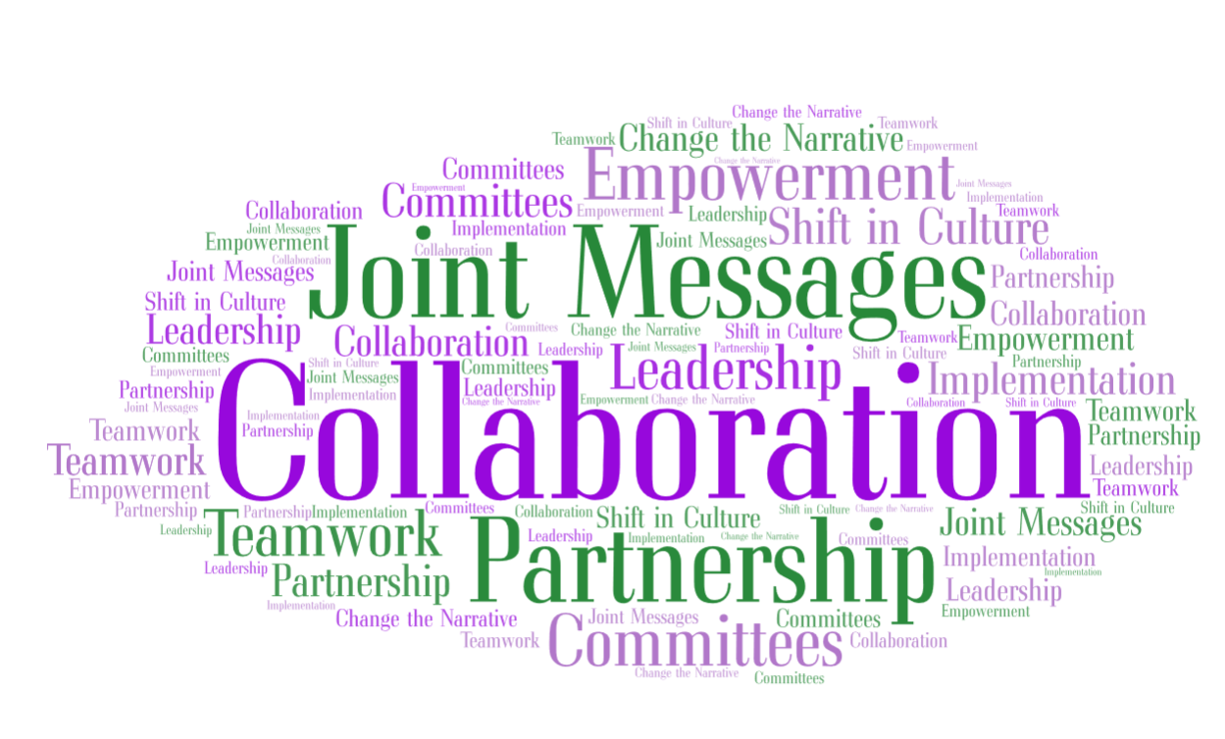
Today, the message is . . .

Slide 28
We Survived!!
Notes:
Cost for all of this:
First round of marketing, for October 4th (after the strike vote) was initially about $100K
In the end, between recruiting messages for teachers and community outreach on radio, TV, movie theater, outside graphics, principal meeting food, misc. and a contract for mediation support on the backside, we were about $500,000. That didn’t include printing cost for curriculum.

